Slide 1

Palantir CASH Module Development Training
v3.8

Slide 2
INTRODUCTION Regimes & Modules

Slide 3
Aims of the Course
Take users of CASH through basics of module writing.
Understand how the framework works with the module suite.
Develop a solid understanding of how to create and customize modules.
Work with standard and Palantir variable and data types.
Navigate around and utilize the development environment and tools.
Error tracking, resolution and testing using debugging.

Slide 4
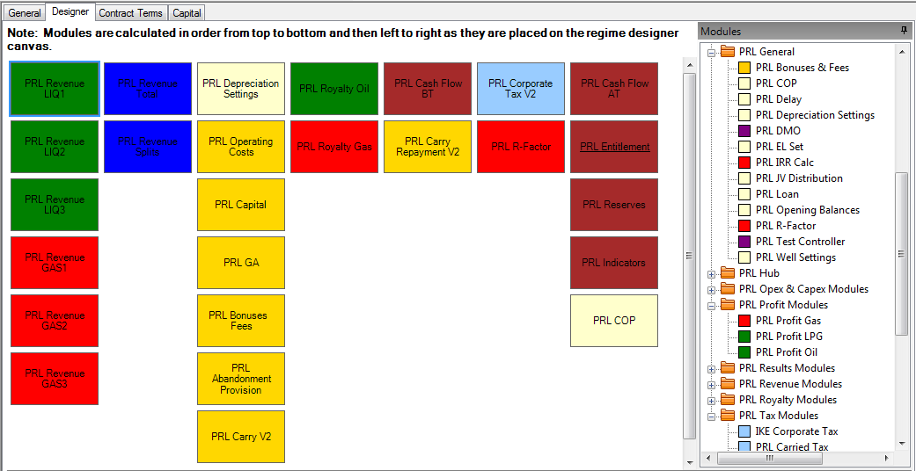
PRL Cash Regimes
Each CASH Regime is made up of one or more Modules
Modules can be dropped onto the designer from the ‘Modules Pane’
Each module in the ‘Modules Pane’ is available for review or edit via the Module Editing Suite (Sharp Develop)
At calculation time modules are
called/executed in a specific order
Top – Down / Left - Right

Slide 5
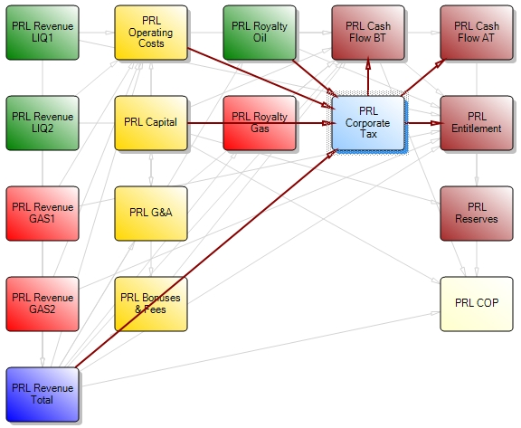
What is a module?
A module is self contained unit, which takes inputs to generate outputs.
Behind each module we
have underlying VB
Visual Basic code to define
it’s functionality.
Inputs from:
Other Modules
User Entries / Projects
Contract Terms
Calculated Outputs:
Can be linked to modules
Used for reporting

Slide 6
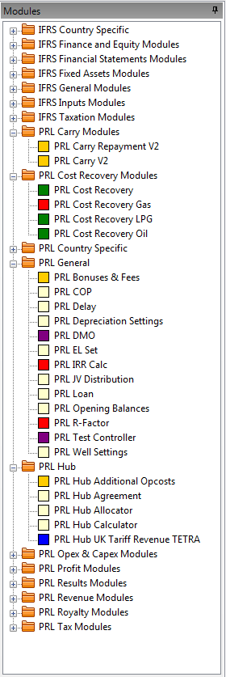
The Modules Pane
The standard PRL (Palantir Regime Library) modules are the core fiscal calculation components for any Regime.
Where the standard modules do not model fiscal activity as required, Custom Module may be used.
All modules can be dragged onto the regime designer and tailored as required.

Slide 7
SharpDevelop (#develop) Open Source Development Environment for .NET

Slide 8
The SharpDevelop Module Editor
Allows direct access to the underlying code behind each module.
Coupled with Palantir CASH, SharpDevelop provides a powerful customized toolset for users to view, edit and build modules.
The main advantages of using SharpDevelop are:
Users can view, edit and organize their module suite as required.
SharpDevelop provides IntelliSense, Microsoft’s implementation of auto-completion.
Allows for design time syntax and error catching.
Provides run-time debugging and testing functionality.

Slide 9
Getting Started
With an installed and licensed version of CASH running on your machine, you can launch the SharpDevelop by either going to Tools > Edit Modules in the CASH menu or by pressing the F6 key on your keyboard.
Access to the SharpDevelop Module Editor can be restricted. If the menu option is not available, contact your CASH administrator.
While SharpDevelop initializes, a temporary set of modules will be created and saved in your working folder.
Any module changes will be saved in this working folder until committed to the database.
Module code in this folder is overwritten with the code from the database each time SharpDevelop is restarted.

Slide 10
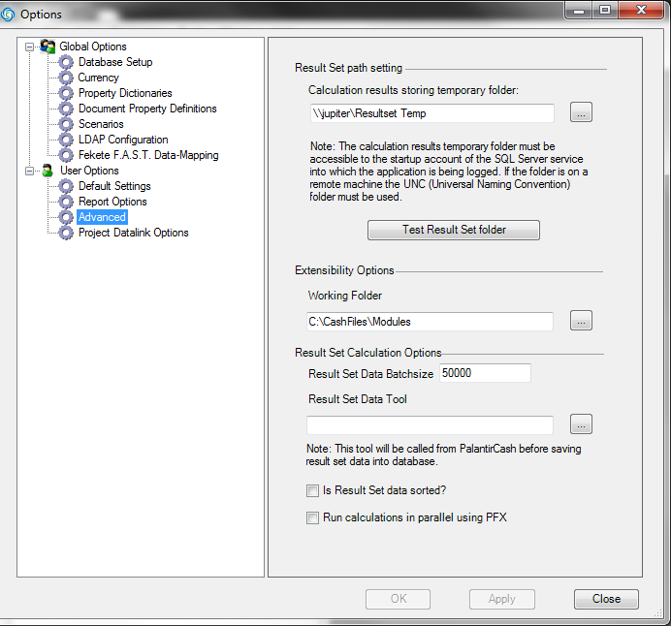
The Working Folder
The working folder is set using the Options window. To specify your working folder go to Tools > Options and select User Options.
Settings
Working Folder = C:\CashFiles\Modules
The Working Folder determines
the destination folder for the PRL
modules from the database.

Slide 11
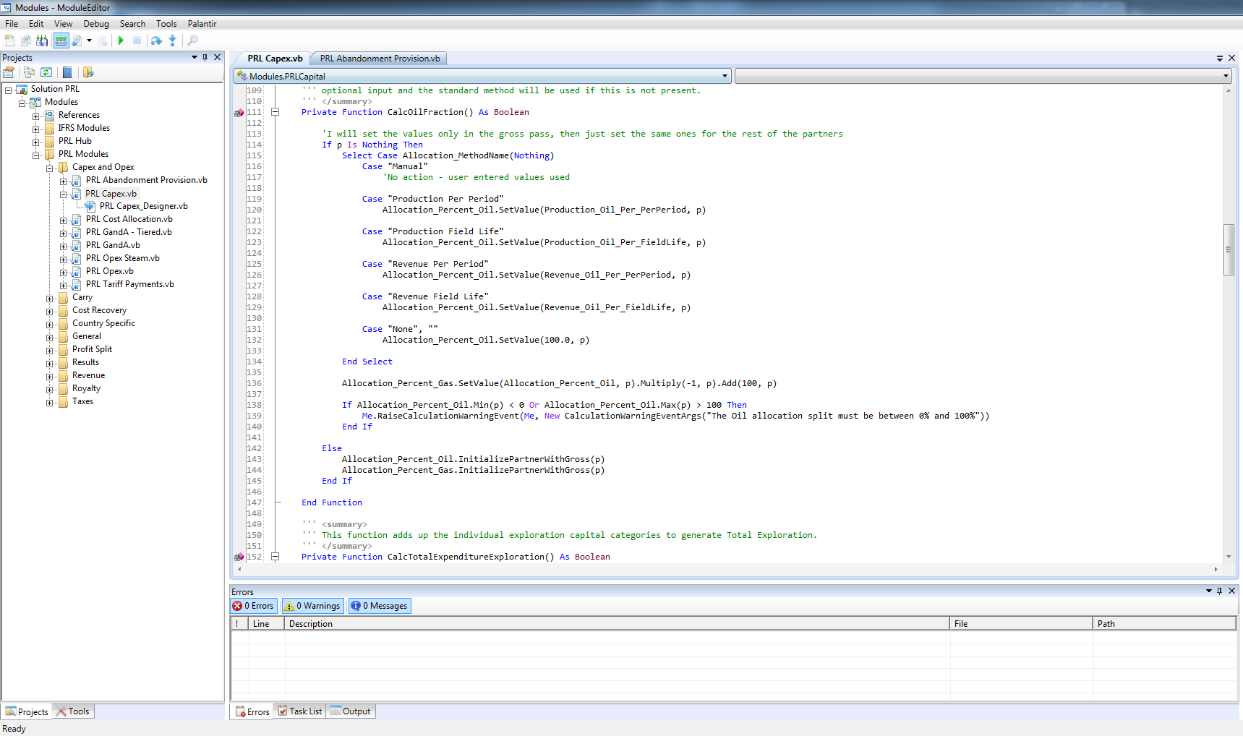
The Development Environment
For those with previous development experience, the SharpDevelop IDE (Integrated Development Environment) has a similar look and feel to the standard Visual Studio IDE.

Slide 12
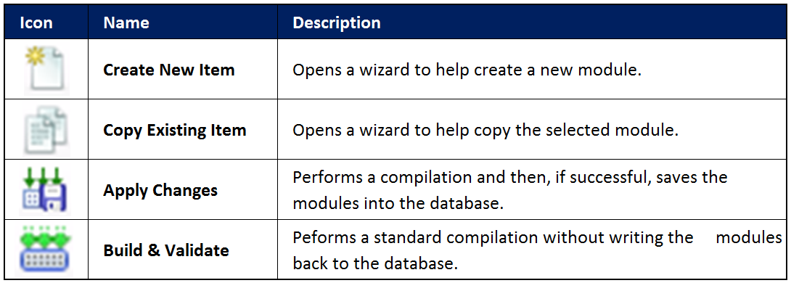
The Palantir Toolbar
The Palantir toolbar provides the core functionality allowing for changes to code, files and the file structure to be compiled, validated and applied to the database.

Slide 13
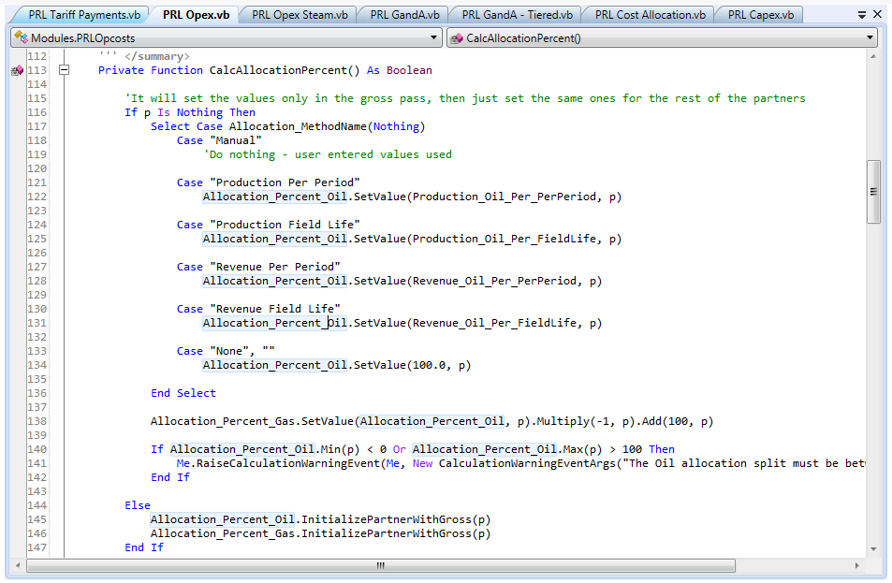
The Code Editor
The Code Editor, opened in the Editor Space is a word processor for the IDE (Integrated Development Environment).
For developers it offers the
following features:
Access to object properties
IntelliSense
Collapsible code sections
Colour coding of keywords
Auto alignment

Slide 14
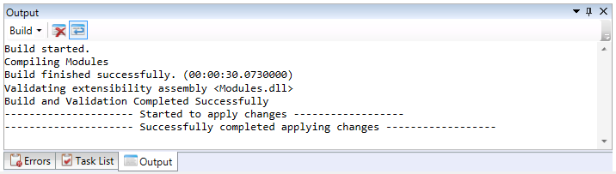
The Output Pane
The output pane (also known as the Output window) is located by default at the bottom of the IDE and can be easily moved anywhere on the screen.
In this context, the pane commonly shows initialisation, validation, build and database application status messages.
Programming errors are generally listed in the Error List.

Slide 15
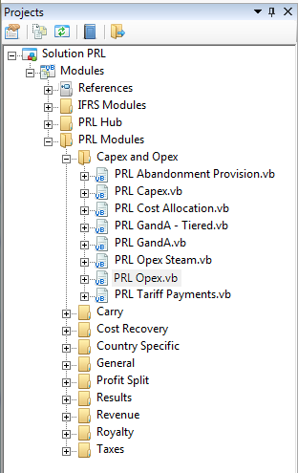
The Project Explorer
The Project Explorer (also known as the Solution Explorer) is used to organize module.
The Module Suite is displayed as a tree of
VB files.
The explorer allows you to open a VB file
for modification and to perform other
standard management tasks.
If the Project Explorer is not displayed in
your IDE, go to the View menu and check
the Project Explorer option.

Slide 16
VARIABLES & DATA TYPES Standard & Palantir Variables / Data Types

Slide 17
Variables
A variable can be defined as a portion of memory used to store a value as an application works though an algorithm/calculation.
The value of the variable can be assigned on declaration and can change by assignment during the process of calculation.
Each newly declared variable requires a unique identifier that distinguishes it from other variables; this is commonly known as the variable name.
Dim TestVariable As Integer
Upon declaration, the variable data type also requires qualification. In the example above, the variable is declared to be of type Integer.

Slide 18
Standard Data Types
Visual Basic has a number of standard data types which the Module Suite extensively makes use of.
The standard data types most commonly used are:
Boolean
Char
Double
Integer
String
There are many other data types that can be used when working with Visual Basic, however those listed above are the most commonly used in the PRL.

Slide 19
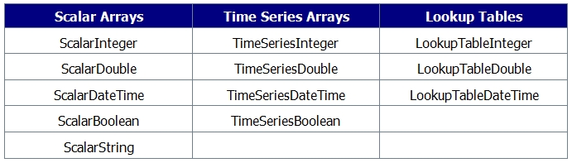
Palantir Data Types
The Module Suite has its own set of predefined data types which can be divided into three groups: Scalars, Lookup Tables and TimeSeries Arrays.
When referencing a variable declared to be of a type listed above, you will be required to specify the correct arguments.

Slide 20
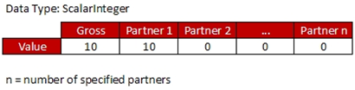
Scalar Data Types
A scalar data type is a one-dimensional array holding values which are accessed by qualifying an index, in this case the partner.

Slide 21
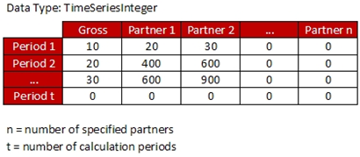
Time Series Types
A TimeSeries Array is a two-dimensional array. The values for this structure can only be accessed by qualifying two indexes; in this case they are the partner and the calculation period.

Slide 22
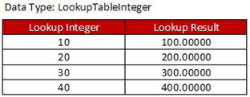
Lookup Tables
Lookup tables are special data types resembling a simple two-dimensional array.
They are used to return a value by performing a check on a predefined table using an argument passed to the table. This argument will be used to look up a corresponding result value.

Slide 23
WORKED EXAMPLE 01 Adding, Deleting & Editing Variables

Slide 24
Exercise 01 Adding, Deleting & Editing Variables
Use the Variable Definition Editor to:
Add 4 new variables (2 ScalarDouble’s and 2 TimeSeriesDouble’s)
Name ScalarDouble’s
Test.SC.Input
Test.SC.Output
Name TimeSeriesDouble’s
Test.TSD.Input
Test.TSD.Output
2) Ensure you ‘Apply’ all changes to ensure they are not lost.

Slide 25
FUNDAMENTAL CONCEPTS Calculation Phases Periodicity Partners & Working Interests

Slide 26
Calculation Phases
When the calculate button is clicked within a project, the calculation sequence begins.
The calculation sequence is divided into eight distinct phases of which only four are accessible.
The program will run in order through each of the eight phases calling modules sequentially as defined.
As each module is accessed, appropriate subroutines will be called and executed as required.

Slide 27
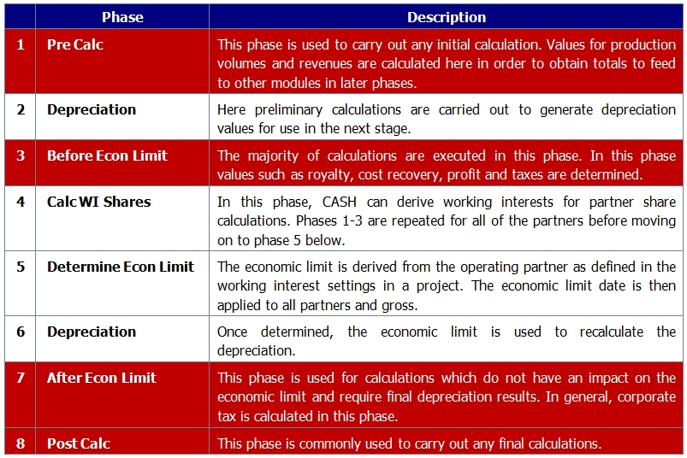
Calculation Phase Table

Slide 28
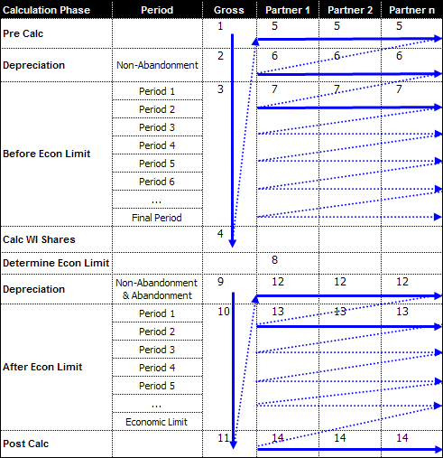
The Calculation Sequence

Slide 29
Periodicity
Periodicity, similar to frequency, determines periods at which Regimes are calculated.
The Periodicity setting is used during the Before Economic Limit and After Economic Limit calculation phases.
Both these phases are defined with a loop and called for each period of the project.
The calculation period is referenced to qualify all TimeSeries variables which are commonly used in the PRL modules.

Slide 30
Partners & Working Interests
Scalar and TimeSeries variables are both indexed by a partner argument.
The partner argument determines the partner for which a value is being assigned or accessed.
The working interest for any specified partner is determined in the project document.
As shown in the calculation sequence diagram, a gross pass is executed first to determine project values.
Beyond this, individual partner values are calculated as CASH runs through the calculation sequence applying the predetermined percentage.

Slide 31
WORKING WITH MODULES Adding, Deleting & Copying Modules

Slide 32
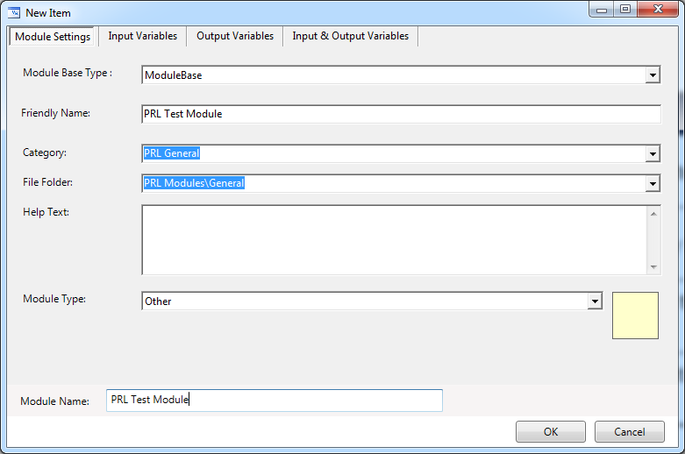
Adding a Module
To add a new module, click on the Add button.
The dialog below allows you to customize the module as required.

Slide 33
Variable Types
INPUT VARIABLES = Act as a source variable for a module
OUTPUT VARIABLES = Act as a result variable for a module
INPUT/OUTPUT VARIABLES = Act as both source and result variables
These variables are often used when a module takes an input and modifies it for use by other modules.

Slide 34
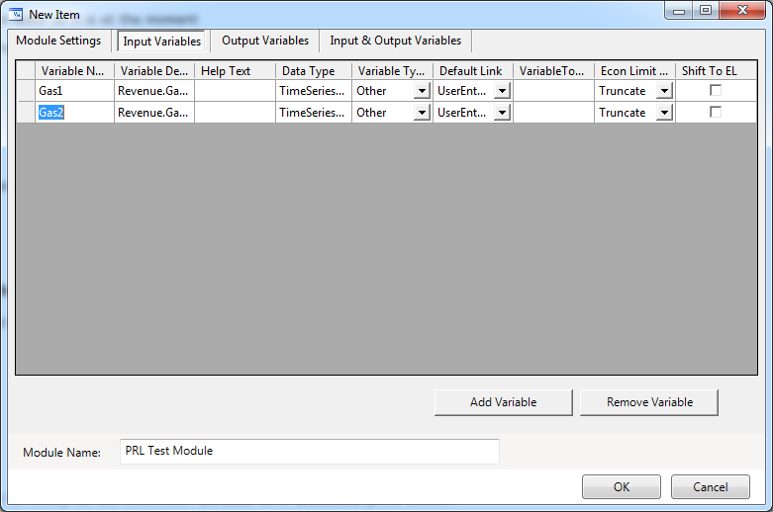
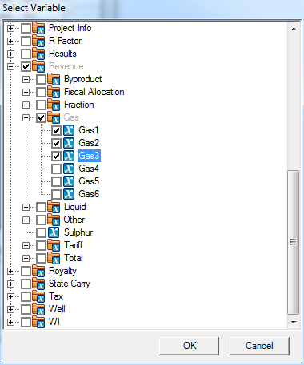
Adding a Variable
Select the variable type by switching to the appropriate tab and click on the Add Variable button.

Slide 35
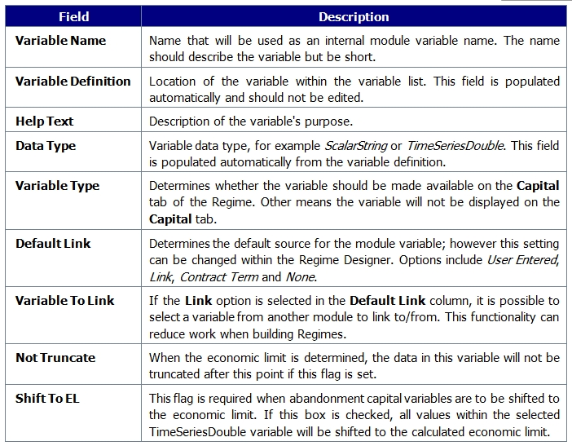
Standard Variable Settings

Slide 36
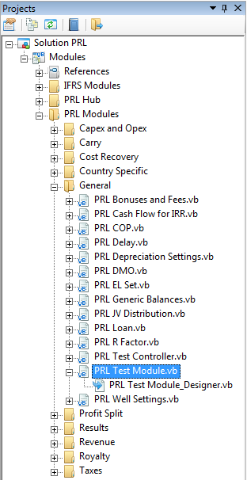
Adding a Module (continued)
Clicking Apply or OK will add the new module to the hierarchy and display the module and designer files in the Project Explorer.
Although added to the hierarchy, the new
module has not yet been added to the
database. To do this click the
Apply Changes button on the Palantir
Toolbar.

Slide 37
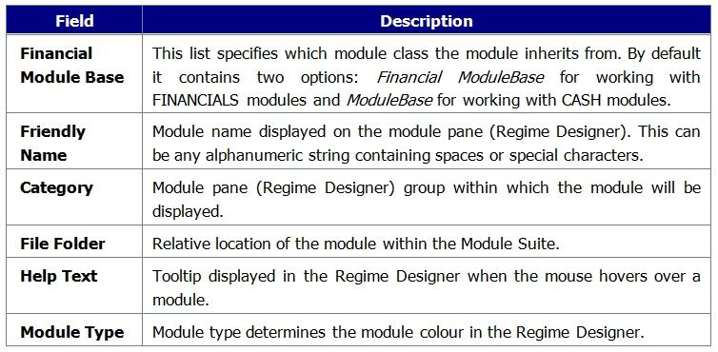
Module Settings

Slide 38
WORKED EXAMPLE 02 Adding a New Module and Using the Module Editor

Slide 39
Exercise 02 Adding a new module to your database.
Use the Module Editor Window to:
Add a new module with the following features:
Name = TestModule
Financial Module Base = ModuleBase
Friendly Name = Test Module
2) Add 3 input, 3 output and 3 input/output variables of your choice with settings as you require.
3) Close the Module Editor Window (first click Apply) and Apply your change to the database.
4) Close SharpDevelop and open any regime, add your newly created module to the regime.

Slide 40
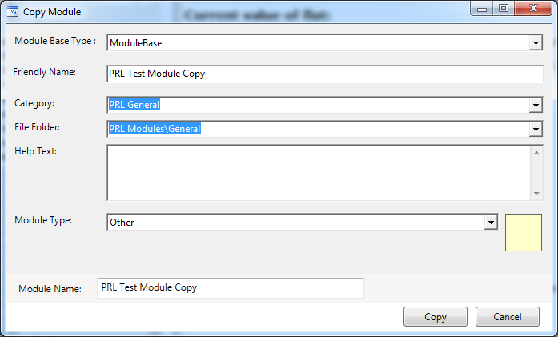
Copying Modules
As a user you may find there is a greater need to copy and customize modules then create a module from scratch.
The process for this is simple.
Click the ‘Copy Existing Item’ button from the Palantir Toolbar
Update the Copy Module dialog with the settings for your new module
Click the Copy button to add the module to the Project Explorer
Apply the module to the database

Slide 41
WORKED EXAMPLE 03 Copying Existing Modules

Slide 42
Exercise 03 Manually copying a module in your database.
Use the SharpDevelop Project Explorer to:
Copy an existing module with the following settings:
Original Module = PRL Simple VAT
New Module Name = Palantir Tax
Financial Module Base = ModuleBase
Friendly Name = Palantir Tax Module
Class Name = PalantirTaxModule
Apply your change to the database and correct errors if flagged.
Close SharpDevelop and open any regime, add your newly created module to the regime.

Slide 43
Deleting Modules
Deleting a module is as simple as selecting the module you want to remove from the Modules drop-down list and clicking on the Remove button.
The module will be deleted from the Module Suite but this change will only be visible in SharpDevelop once you click on the Apply or OK button in the Modules Editor window.
NOTE: Removing a module from the Module Suite can have a profound effect if the deleted module is used by one or more Regimes.
If you delete a module in SharpDevelop without first removing it from Regimes, all Regimes that use that module will stop functioning and a warning will be displayed when you try to open a broken Regime.

Slide 44
MODULE CODE Features of the Code

Slide 45
Partial Classes
Each module within the PRL is broken down into two distinct components:
IMPLEMENTATION FILE - Defines the functionality of the module.
DESIGNER FILE - Contains class and variable declarations.
The implementation and designer files work together to define the functionality of the module.
Both files are linked via the class declaration in the designer file and the reference to the class in the source file.
These partial classes are therefore merged to build the class from which objects are created.

Slide 46
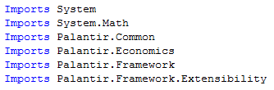

Module Code
Copyright Information
Import Statements
Region Statements

Slide 47
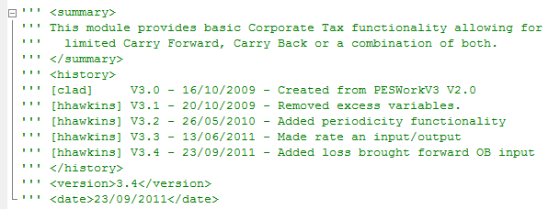
Module Code (continued)
Summary, History & Version Information

Slide 48
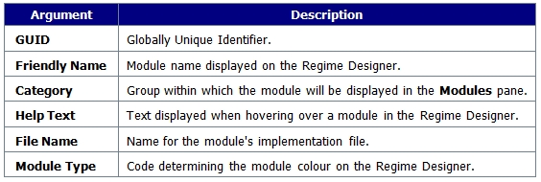
The Designer File
The Class Definition is based on the setting entered in the Module Editor.

Slide 49
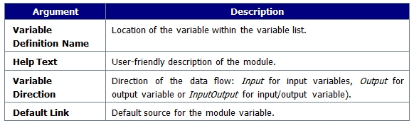
The Designer File (continued)
VARIABLE DEFINTIONS
The following regions contain the module variable definitions as specified in the Module Editor:
Input Variables,
Output Variables
Input/Output Variables.

Slide 50
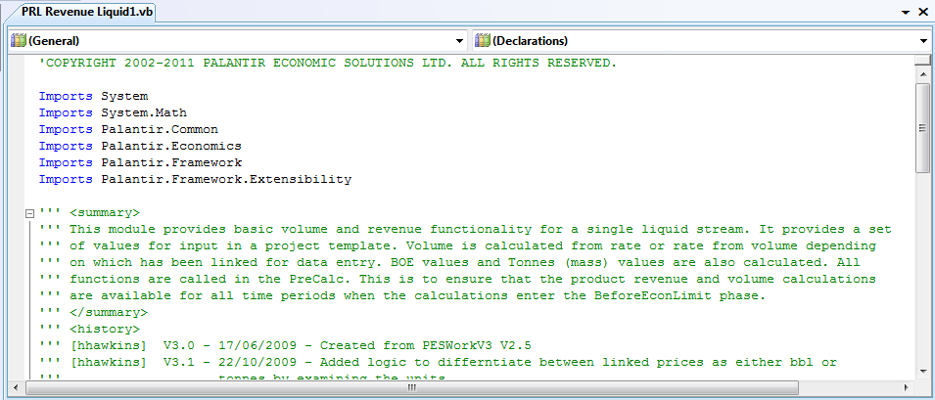
The Implementation File
The implementation file is generated to work with the designer file.
The main body of the partial class is enclosed between the Public Partial Class & End Class statements.
The class name specification ensures that all partial classes are bound together to define the entire class.

Slide 51
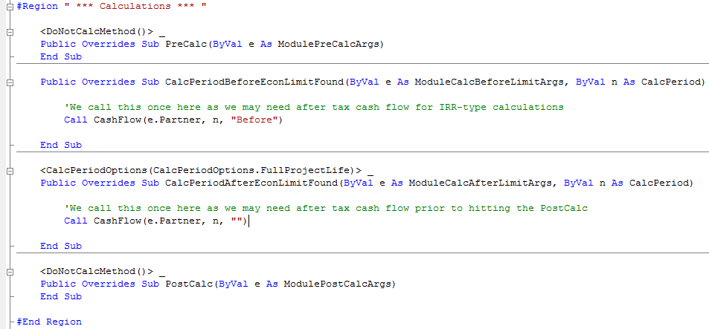
Calculation Phases
The Calculation Phase subroutines are called in order during project calculation.

Slide 52
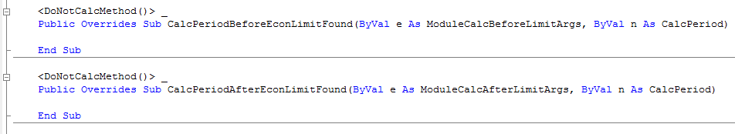
<DoNotCalcMethod()>
A subroutine may be prefixed by the <DoNotCalcMethod()> statement.
This statement is commonly used to confirm that the specified calculation stage can be ignored.
Making use of this statement may significantly speed up the project calculation.
Making use of this statement is not considered a mandatory requirement.

Slide 53
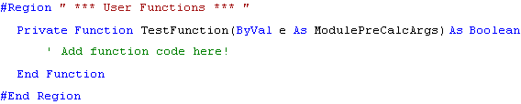
User Functions
All Implementation files have an allocated area for User Functions.
In modules generated created using the Module Editor, this would be blank.
The functions defined in this area are called from a specific calculation phase subroutine.

Slide 54
WORKED EXAMPLE 04 Creating a New Module to be Tested with Regimes

Slide 55
Worked Example Creating a new Module to be tested with Regimes
Using the Module Editor create 3 variables (all ScalarDouble’s)
Add a new module, add the 3 variables as input, output & input/output.
PreCalc Phase: Remove DoNotCalculate qualifier and add code to modify the input to determine the output.
Additionally, update the input/output variable.
Build, Validate & Apply Module to Database
Create a new regime, update project template and test changes.

Slide 56
Exercise 04 Create a new Module for use with Regimes & Reports
Create using the Variable Editor Window 3 variables (All ScalarDoubles)
xyz.Input
xyz.Output
xyz.InputOutput
Using the Module Editor Window add a new module with the following features:
Name = MyModule
Financial Module Base = ModuleBase
Friendly Name = MyModule
Add the 3 created variables to your module as an Input, Output & InputOutput.
Add a fourth variable as an output Revenue.Total.TOTAL
Close the Module Editor Window (first click Apply) and Apply your change to the database.

Slide 57
Exercise 04 (continued) Create a new Module for use with Regimes & Reports
Using SharpDevelop open the MyModule module code and edit the code as follows:
Remove the DoNotCalculate qualifier before the PreCalc Phase (if it is there).
Add code in the PreCalc section to multiply your input variable by 5 to give you an output variable.
Output(e.Partner) = Input(e.Partner) * 5
Add code in the PreCalc section to modify the input/output variable.
InputOutput(e.Partner) = InputOutput(e.Partner)/ 2
Apply your change to the database and correct errors if flagged. Close SharpDevelop .
Use CASH to create a new regime called ‘xyz’.
Add your newly created module to the regime.
On the Input tab, set xyz.Input & xyz.InputOutput as User Entered

Slide 58
Exercise 04 (continued) Create a new Module for use with Regimes & Reports
On the General Tab of the Regime
Set the Module Weighting Variable as xyz.Input
Set the ‘Choose Economic Limit’ varaiable as Revenue.Total.TOTAL
Edit the regime project template adding the following variables
Inputs
xyz.Input
xyz.InputOutput
Inputs
xyz.Output
xyz.InputOutput
Save your regime!
Add your regime to a hierarchy and create a new project to test your module.

Slide 59
Exercise 04 (Add-On) Extend ‘MyModule’ to make use of TimeSeriesDoubles
Use the Variable Definitions Window to create 3 TimeSeriesDouble variables.
xyz.TSDInput xyz.TSDOutput xyz.TSDInputOutput
Use SharpDevelop to update the ‘MyModule’ module:
Add your new variables, 1 as input, 1 as output and 1 as input/output.
Add code in the BeforeEconomicLimit section to model the following:
OutputTSD(n, e.Partner) = InputTSD(n, e.Partner) * 2
InputOutputTSD(n, e.Partner) = InputOutputTSD(n, e.Partner) * 10
Apply your changes to the database and correct errors if flagged. Close SharpDevelop .
Edit the regime you created updating the project template adding your new inputs, outputs and a date range.
Open your existing project to test your module.

Slide 60
MODULE DEVELOPMENT Subroutine & Function Programming

Slide 61
Module Development
Once generated or copied, implementation files can be tailored to model the core fiscal calculations.
For regular users of CASH, the modules are a series of colour-coded rectangles positioned in a defined sequence.
Each module has a set of defined inputs which are fed into the module and used to generate a set of outputs via a sequence of calculations.
Functions are called from specific phase subroutines to allows the programmer to dictate when specific calculations are executed.
Well-designed, structured and methodical code can drastically reduce the calculation time of a project.

Slide 62
Sub Routine Arguments
Each phase subroutine is qualified with phase-specific arguments.
The arguments give the developer access to the partner being referenced and calculation period specified.
Each of the four accessible phase subroutines is qualified with a module calculation argument ‘e’ which is specific to each subroutine.
The ‘e’ qualifier can be expanded to access calculation-specific settings for the module.
The second argument, Calculation Period is only available in 2 phase subroutines.
The argument is referenced using the ‘n’ qualifier and can be expanded to determine the current calculation period.

Slide 63
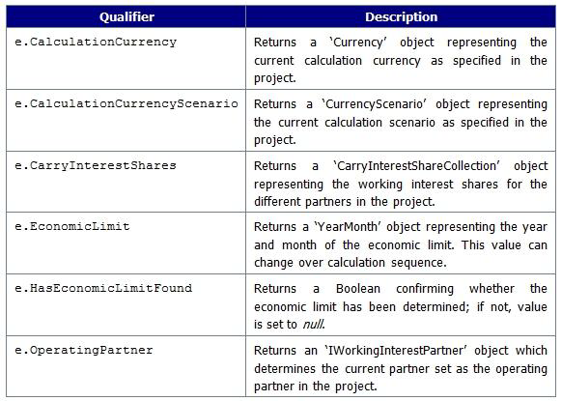
The ‘e’ Argument (part 1)

Slide 64
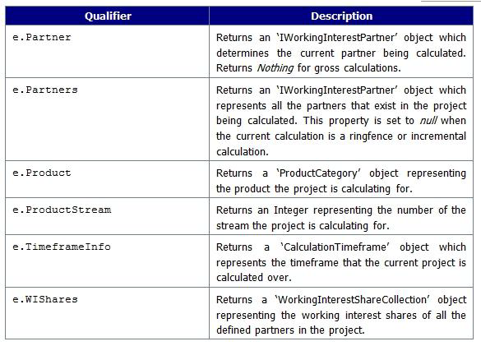
The ‘e’ Argument (part 2)

Slide 65
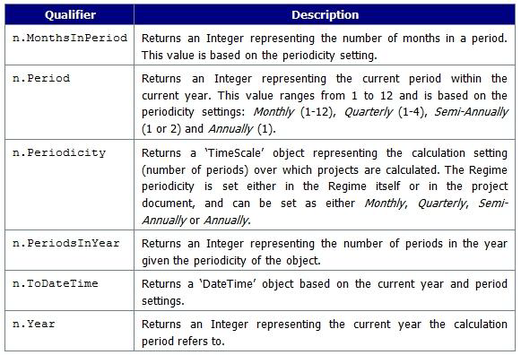
The ‘CalcPeriod’ Argument

Slide 66

Adding Functions
All newly generated implementation files start with an empty User Functions region.
In the example below, a new function has been added to the User Functions region.

Slide 67
Calling Functions
For the contents of any function to be executed, the function needs to be called from within another function or subroutine.
Function calls require appropriate arguments to be qualified in the function header.
Here the function name is preceded by the Call statement followed by the function name.
If the number of arguments or argument types do not match the function declaration, the build and validation of the project will fail raising an error.

Slide 68
Variable Scope
Variable scope defines when a variable is accessible.
When a variable is declared, it will only be available to certain parts of code.
The variables defined and accessed by module functions have two levels of scope:
LOCAL - Variables can be accessed in the current function only.
MODULE – Variables can be accessed throughout the module.
Local variables are generally used to aid calculation processes and make code easier to read and understand.

Slide 69
CODE VALIDATION Building, Validating & Applying Projects

Slide 70
The Validation Process
All code changes in source code require compilation before an executable format can be generated.
In the Palantir Module Suite, this compilation process is broken down into three stages: (1) Building (2) Validating (3) Application
The Palantir toolbar gives developers quick and easy access to these tools.
Standard SharpDevelop functionality is used to report errors, if any.

Slide 71

Building Projects
The PRL Module Suite is built and tested using the SharpDevelop IDE.
Developers generally build a project repeatedly during the development and testing process.
In most instances this process begins with compile-time errors which require correction.
Errors can include incorrect syntax, references and logic.
The Build option is invoked by clicking the Build Option button on the Palantir toolbar.

Slide 72
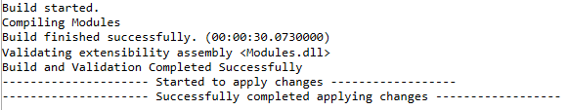

Validating Projects
The status of the Build and Validate process is displayed in the Output window.
The build process generally completes with a positive or negative result.
If no errors are identified, the process provides positive feedback.
Alternatively if errors are identified, a failed build is highlighted.

Slide 73
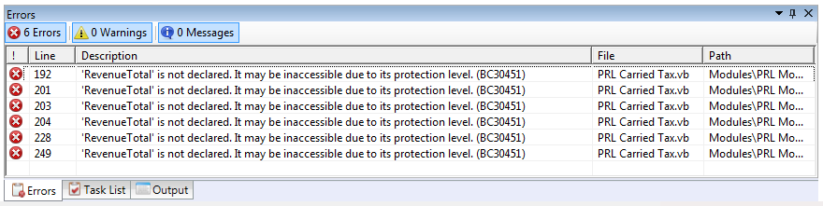
Error List Window
During the development process, the Error List window keeps an up-to-date list of identified errors.
The window displays errors, warnings and messages during module development.
If you double-click on an identified error, SharpDevelop will open the file where the error is and show the error location.

Slide 74

Applying Changes
Once the Build and Validate process creates a successful build, the changes need to be applied to the database.
To apply, simply click on the Apply Changes button on the Palantir toolbar.
This will invoke the Build & Validate function if not already called.
If the build is successful, the changes are saved to the database.
Once applied, the changes will form part of the calculation sequence when a project is next calculated.
If changes are not successfully committed to the dB, they will be lost!

Slide 75
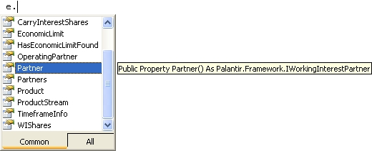
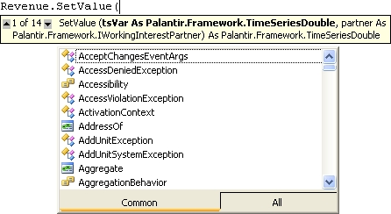
IntelliSense
IntelliSense is a drop-down list that
appears when a recognized word is
being entered into the code editor.
Another useful feature of IntelliSense
is the ability to display a list of
parameters for an available function
or method.

Slide 76
WORKED EXAMPLE 05 Calling Functions from AfterEconomicLimit Phase

Slide 77
Worked Example Calling functions from AfterEconomicLimit Phase
Created using Module Editor
Create and Add 2 variables (both TimeSeriesDouble) to an existing module
Add a function which takes input and multiplies by 5
Ensure your new function is called from the AfterEconomicLimit Phase
Build, Validate & Apply Module to Database
Add module to regime and test project

Slide 78
Exercise 05 Create a Simple Function
Use the Module Editor to create a new module with no variables:
New Module Name = SimpleCalc
Financial Module Base = ModuleBase
Friendly Name = SimpleCalc
Class Name = SimpleCalcClass
Create & Add 2 TimeSeriesDouble variables to your module. (1 Input & 1 Output)
Create a function that is called from the AfterEconomicLimit phase.
Add code to take your input and multiplies by 50 to give your output.
Build, Validate & Apply your Project.
Close SharpDevelop and add your new module to your regime to test your new module.

Slide 79
WORKED EXAMPLE 06 Using Existing Variables for Calculations

Slide 80
Worked Example Using Existing Variables for Calculations
Make a copy of your Simple Module using the Project Explorer
Use the Module Editor to add Generic.Generic1 as an input & Generic.Generic2 as an output to the Simple Module
Create a new function called during the Before Economic Limit Phase to use the external variables
Build, Validate & Apply module to database
Update the regime and set the input as Contract Term
Create report to report the result
Run and test project

Slide 81
Exercise 06 Simple Module Extension – Using Existing Variables
Manually, copy your SimpleCalc module.
Use the Module Editor to add Generic.Generic1 as an input & Generic.Generic2 as an output to your SimpleCalc module.
Create a new function called at the Before Economic Limit phase to make use of the added variables.
Build, Validate & Apply your Project.
Update your regime to make use of the newly added variables
Create a report to test your changes
Run and test your project.

Slide 82
PROGRAMMING THEORY Basic Coding Examples

Slide 83
Programming Theory
Code Commenting
Variable Definitions
IF Statements / Logic
Case Statements
Loops (For, Do-While, While)
Variable calculations in the PreCalc phase
Using Lookup Tables in code
Where partner = Nothing = Gross Values
Setting p as Working Interest Partner >>> p = e.Partner

Slide 84
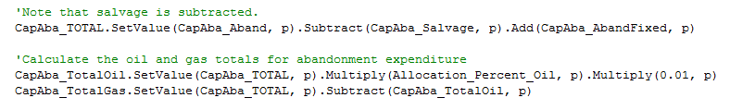
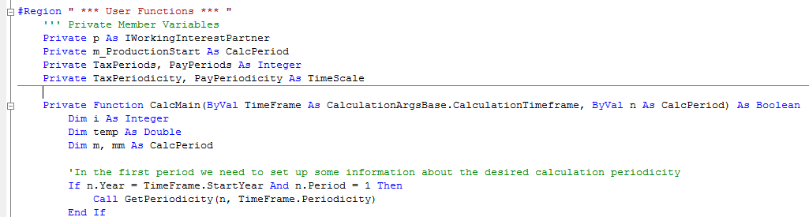
Programming Theory
Code Commenting
Variable Definitions

Slide 85

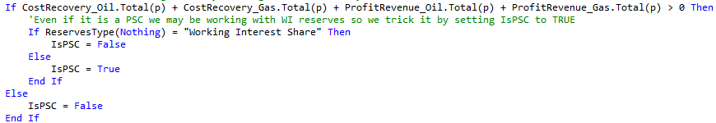
Programming Theory (continued)
IF Statements & Logic

Slide 86
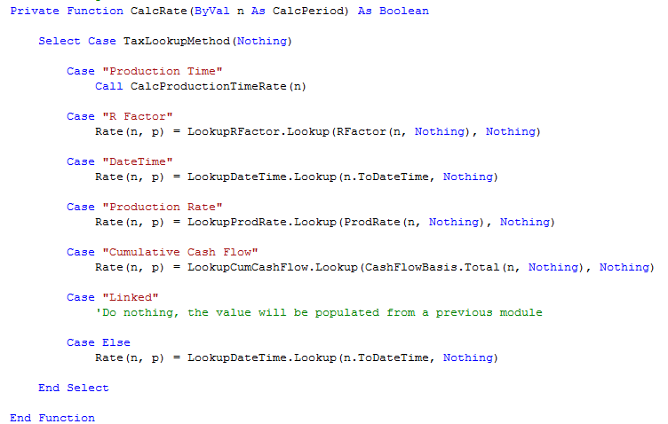
Programming Theory (continued)
CASE and SELECT Statements

Slide 87
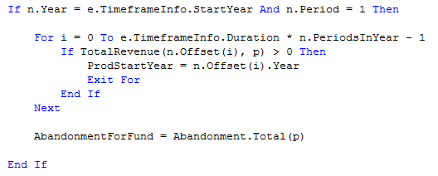
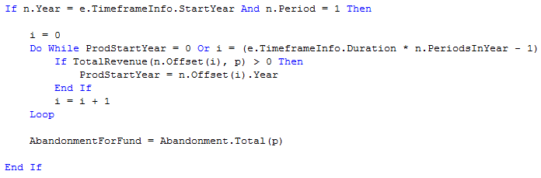
Programming Theory (continued)
FOR Loops
WHILE Loops

Slide 88
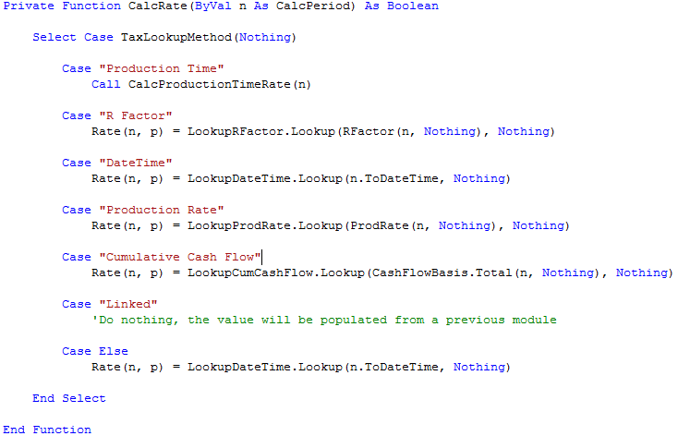
Programming Theory (continued)
LookUp Tables & Gross = Nothing

Slide 89
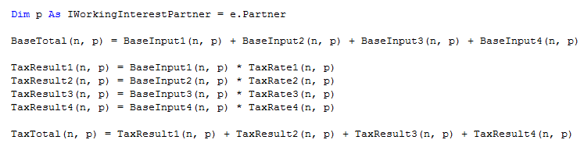
Programming Theory (continued)
Dim p As IWorkingInterestPartner = e.Partner

Slide 90
WORKED EXAMPLE 07 Using IF Statements and Booleans

Slide 91
Worked Example Using IF Statements and Booleans
Make use of the SimpleCalc module created
Add 2 new Scalar variables, 1 ScalarInteger & 1 ScalarBoolean
Add the 2 new variables to the module as Contract Terms
Place an IF statement in the code making use of the ScalarBoolean to determine whether to execute the calculation, ensure the calculation now uses your ScalarInteger.
Build, Validate & Apply module to database
Run and test project

Slide 92
Exercise 07 Using IF Statements and Booleans
Using the SimpleCalc module you have created
Create and Add 2 new Scalar variables (1 ScalarBoolean, 1 ScalarInteger)
Add the 2 new variables to your module, ScalarBoolean as Input, ScalarInteger as Output.
Place an IF condition making use of the ScalarBoolean, if True set the value of your ScalarInteger to 500.
Build, Validate and Apply your changes.
Set your new ScalarBoolean as a Contract Term and add your new ScalarInteger to your Project Template as a Result.
Test your code switching the Contract Term ScalarBoolean

Slide 93
WORKED EXAMPLE 08 The Simple Tax Module

Slide 94
Worked Example The Simple Tax Module
Use the Project Explorer to make a copy of the Simple VAT Module
Create 2 new input variables to link ‘revenue’ and ‘deductions’ to your module (TimeSeriesDouble)
Create 2 new output variables to link ‘newtax’ and ‘totaltax’ to your module (TimeSeriesDouble)
Update the copied module to include your new variables
Add a new function, to calculate your new tax and total tax which is the sum of your new tax and the existing tax
Update your regime to make use of the newly added variables
Run/test your project linking the ‘newtax’ & ‘totaltax’ variables as results

Slide 95
Exercise 08 The Simple Tax Module
Use the Project Explorer to make a copy of the Simple VAT Module
Create 2 new input variables to link ‘revenue’ and ‘deductions’ to your module (TimeSeriesDouble)
Create 2 new output variables to link ‘newtax’ and ‘totaltax’ to your module (TimeSeriesDouble)
Update the copied module to include your new variables
Add a new function, to calculate your new tax and total tax which is the sum of your new tax and the existing tax
Create and new regime to make use of your updated module
Run/test your project linking the ‘newtax’ & ‘totaltax’ variables as results

Slide 96
CODE EXAMPLES Basic Code Scenarios

Slide 97
Examples
Function Calls
Function Definitions

Slide 98
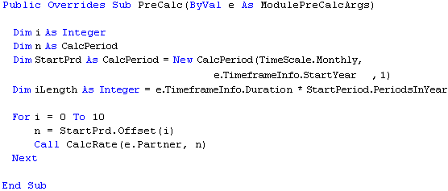

Examples (continued)
Local Periodicity Loops
First Calculated Period Check

Slide 99
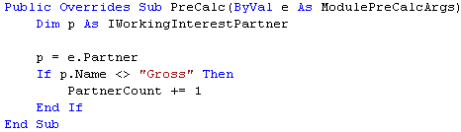
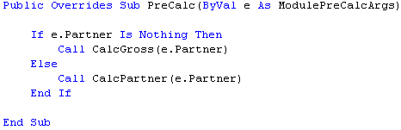
Examples (continued)
Qualifying Partners

Slide 100
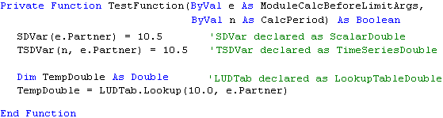
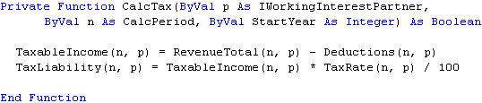
Examples (continued)
Variable Declarations & Assignments
Using PRL Data Types

Slide 101
TESTING & DEBUGGING

Slide 102
Testing & Debugging
Building, debugging and testing are key tasks when developing any application.
Once all build errors are resolved, it is necessary to correct any logical errors which may keep the module from running as intended.
Debugging is the process which allows a developer to locate and fix bugs in the source code.
This is done by pausing and analysing the run-time behaviour of an application, in this case the calculation sequence.
The debugger allows you to suspend the execution of the calculation sequence at any defined point.
From here you can examine the code, evaluate variable values and jump to different points in the execution path.

Slide 103
Attaching the Debugger
To invoke the debugger, click on the Attach Debugger button on the Palantir toolbar.
If the modules have been built and validated successfully, the SharpDevelop debugger will be automatically attached to the running CASH application.
Running in the debug mode allows the user to step through the calculation sequence.
To start a calculation sequence, click on the Calculate Project button in any active project.

Slide 104

Break Points
In the debug mode, the calculation sequence will run through without pausing if no point has been flagged for the execution path to pause.
To force the calculation sequence to pause at a specific point, a break point needs to be added to the module code.
To add a break point, navigate to the
required line of code, right-click and
select the appropriate option from
the context menu.
Alternatively, hit the F7 key.
If a break point has been successfully added, a red dot will be inserted into the margin of the module code.

Slide 105

Debugging Options
When a break point has been added and a project is set to calculate, the calculation will pause at the defined point of the calculation sequence.
At this point you have
the option to view the
status of any declared
variable and step
through code.

Slide 106

Module Debugging

Slide 107
WORKED EXAMPLE 09 Debugging a Test Project

Slide 108
Worked Example Debugging a Test Project
Start the Debugger and add a breakpoint to stop the code in the Corporate Tax Module
Step through the code (highlighting Step Into, Step Over, Step Out)
Demonstrate how we use the Watch, Local & Immediate windows.
Show how we use the ‘Run to Cursor’ functionality
Finally, explain how we stop the Debugger.

Slide 109
FRAMEWORK ATTRIBUTES Accessible Framework Attributes

Slide 110
Framework Attributes
In addition to the members of the PRL Module Suite, there are a number of accessible attributes which are available via the Me. qualifier.
The qualifier contains calculation-specific attributes which can be easily accessed via the dot operator.
A detailed set of definitions is available in our Module Development Guide.

Slide 111

Any Questions

Slide 112

THE END
You are now a
JEDI MASTER
in
MODULE DEVELOPMENT

